Slide 1
Overview of the Canadian Water Flow Account
Regional Seminar on the System of Environmental-Economic Accounts (SEEA) Central Framework in the Caribbean
February 6-7, 2014
Castries, Saint Lucia
Joe St. Lawrence
Statistics Canada

Slide 2
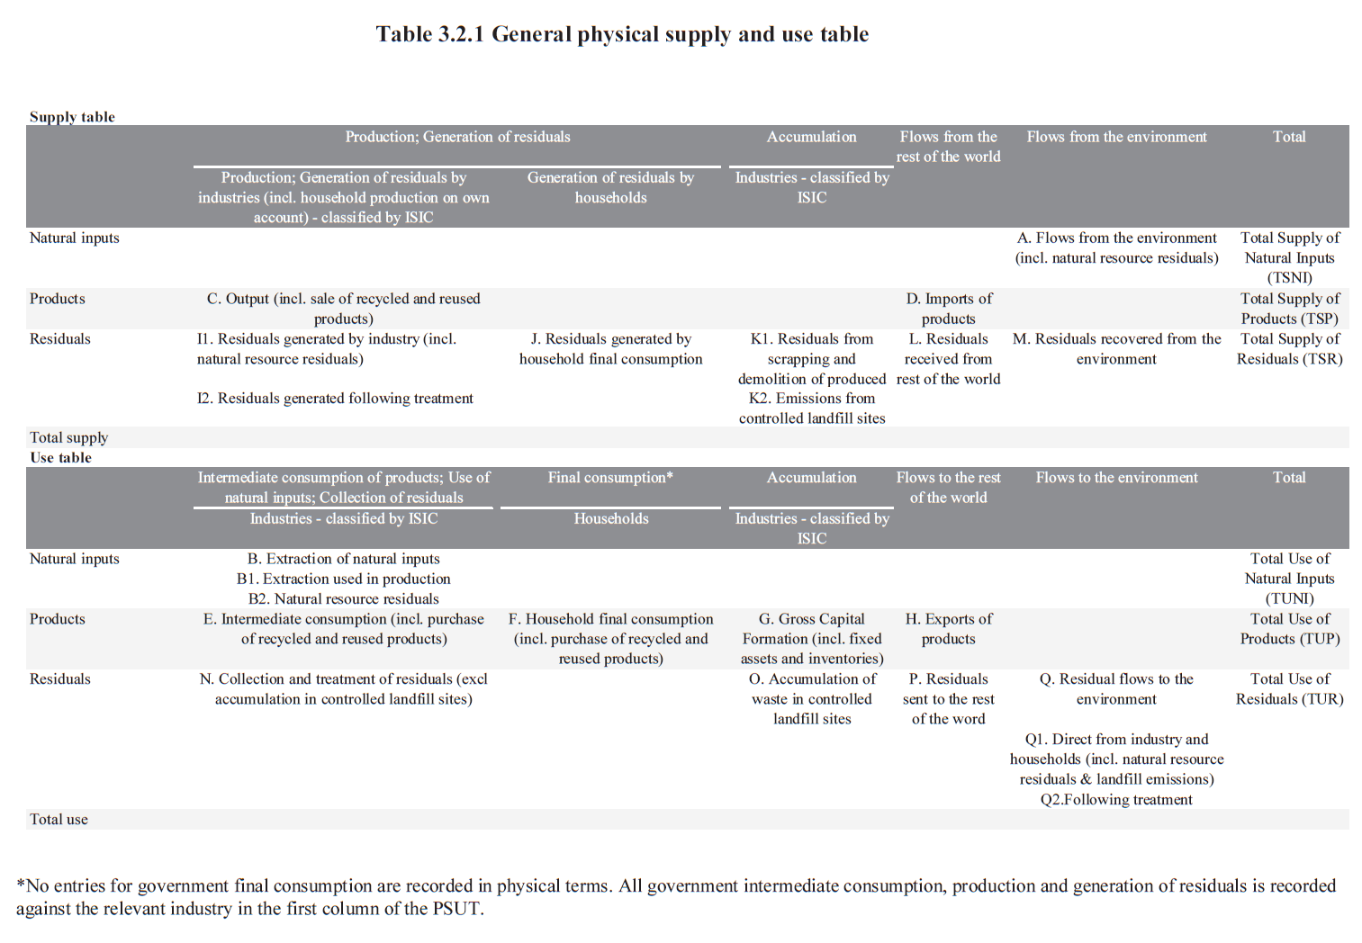
Physical Flow Accounts in the SEEA

Slide 3
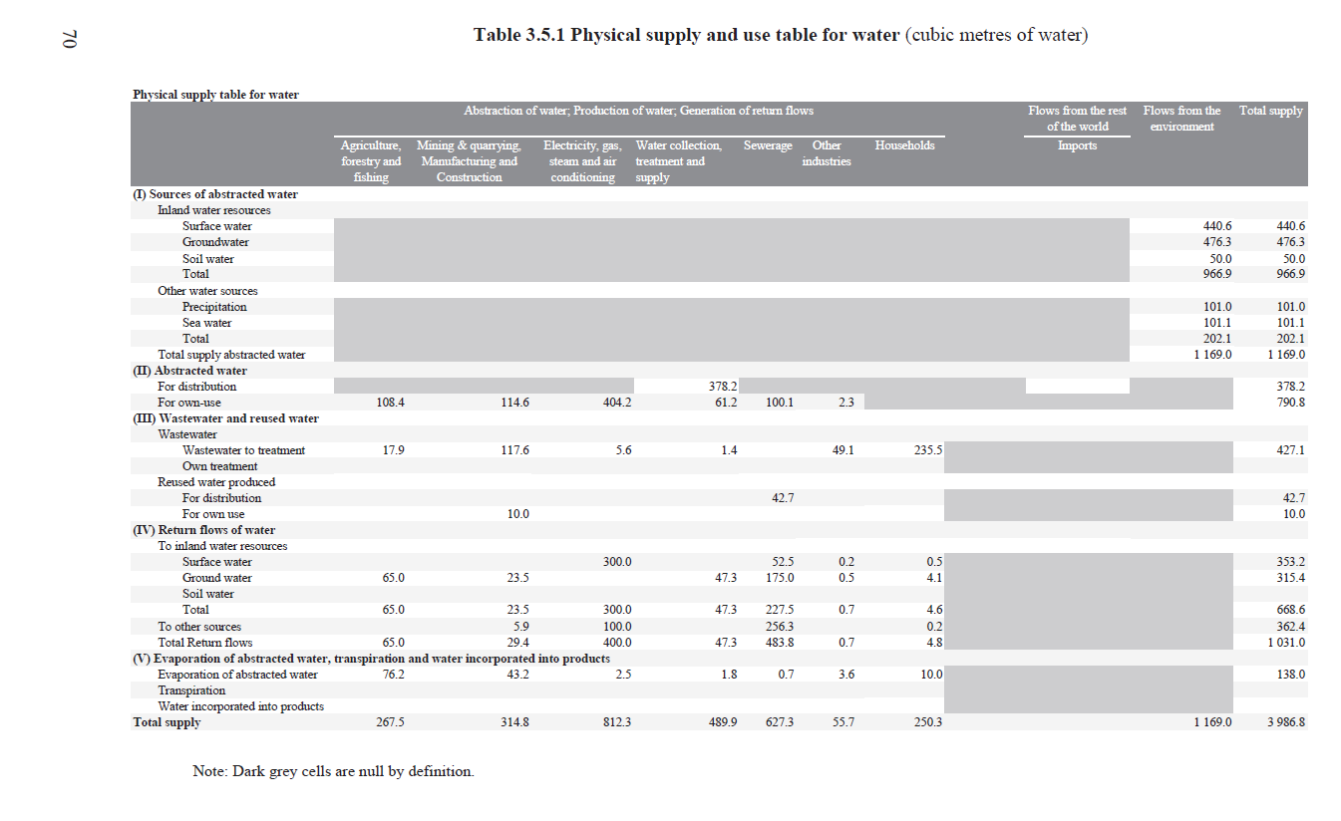
Water Accounts in the SEEA: Supply

Slide 4
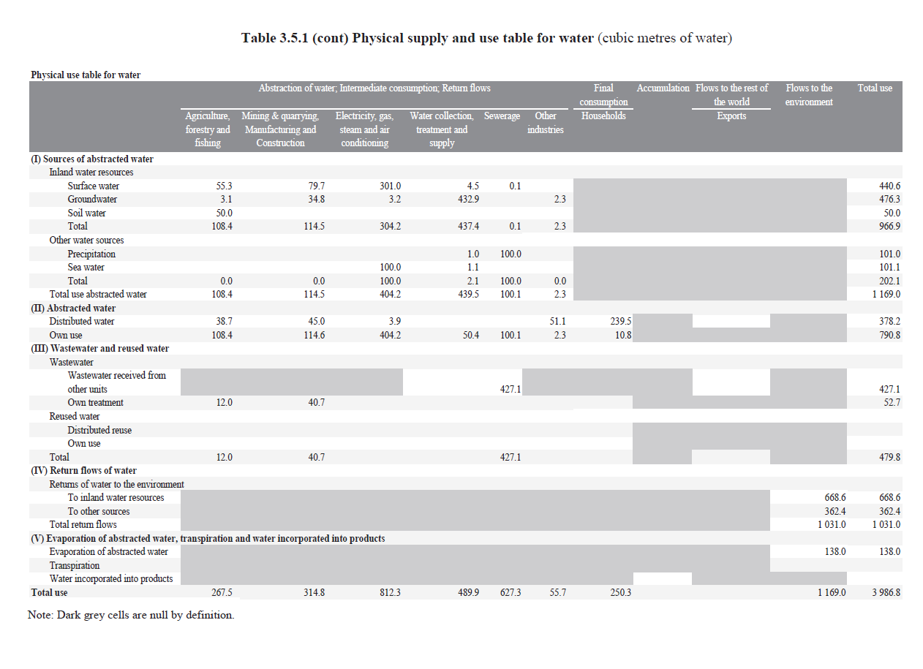
Water Accounts in the SEEA: Use

Slide 5
Water Accounts in Canada

Slide 6
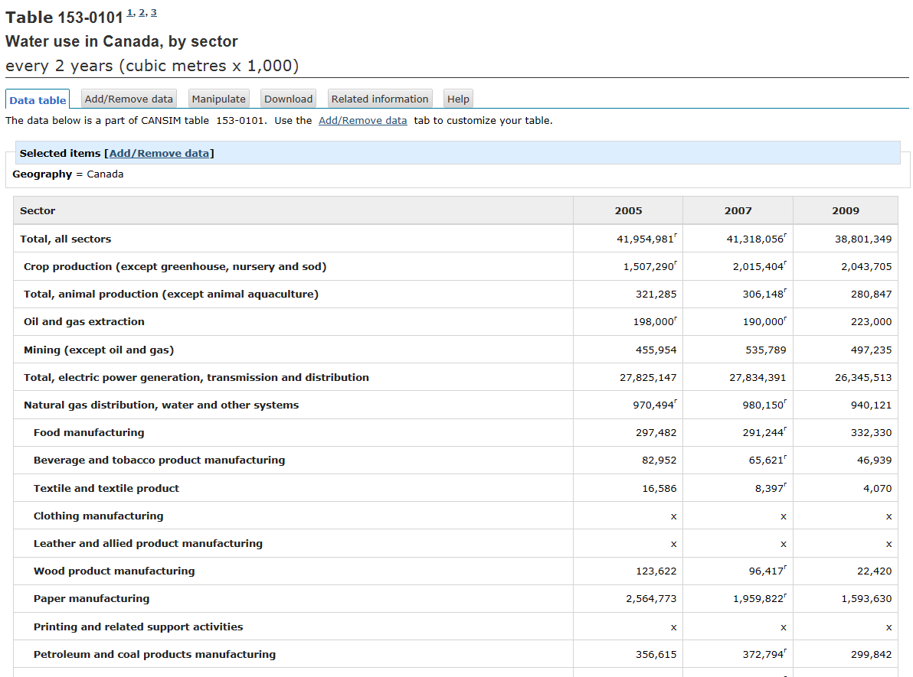
Water Use Accounts in Canada: Basic table

Slide 7
Water Accounts Uses
Impact analysis for International Trade
Environmental Sustainability Indicators
CGE modelling
Analysis of water use
Etc…

Slide 8
Overview of Main Data Sources
Industrial Water Use Survey
Mining, Manufacturing, and Thermal Power. Oil and gas extraction estimate provided by the Canadian Association of Petroleum Producers.
Agricultural Water Use Survey
Irrigation for all provinces outside Alberta. Alberta estimate from Alberta Agriculture and Rural Development.
Survey of Drinking Water Treatment Plants
Control Total for municipal supply. Estimate for losses and commercial, industrial and residential split.
Input-output Tables
Water supplied through mains expenditure based allocation for users not surveyed above (proposed)

Slide 9
Challenges
Periodicity of source surveys
Lack of detailed data for industries, particularly in the commercial and institutional sector
Difficulty of collecting household use data directly

Slide 10
Questions?
Joe St. Lawrence
Environment Accounts and Statistics | Comptes et statistique de l'environnement
R.H. Coats Building | Immeuble R.-H.-Coats / Floor | Étage 25 M
Statistics Canada | 100 Tunney's Pasture Driveway, Ottawa ON K1A 0T6
Statistique Canada | 100, promenade Tunney's Pasture, Ottawa ON K1A 0T6
Joe.St.Lawrence@statcan.gc.ca
Telephone | Téléphone 613-951-7709
Facsimile | Télécopieur 613-951-0634
Government of Canada | Gouvernement du Canada

